Slide 1
19AD784
IMAGE ANALYSIS AND COMPUTER VISION
Dr E Emerson Nithiyaraj
AP/ECE

Slide 2
Color Fundamentals
Radiance is the total amount of energy that flows from the light source, and it is usually measured in watts (W).
Luminance, measured in lumens (lm), gives a measure of the amount of energy an observer perceives from a light source.

Slide 3
Color Fundamentals
Cones are the sensors in the eye responsible for color vision.
Detailed experimental evidence has established that the 6 to 7 million cones in the human eye can be divided into three principal sensing categories, corresponding roughly to red, green, and blue.
Approximately 65% of all cones are sensitive to red light, 33% are sensitive to green light, and only about 2% are sensitive to blue (but the blue cones are the most sensitive).

Slide 4
Color Fundamentals
Due to these absorption characteristics of the human eye, colors are seen as variable combinations of the so-called primary colors red (R), green (G), and blue (B).
For the purpose of standardization, the CIE (Commission Internationale de l’Eclairage—the International Commission on Illumination) designated in 1931 the following specific wavelength values to the three primary colors: blue = 435.8 nm, green = 546.1 nm and red = 700 nm.

Slide 5
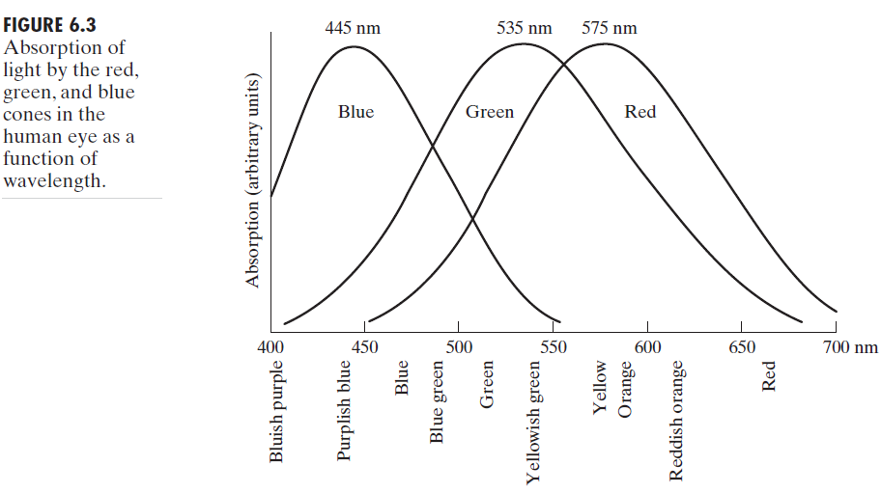
Color Fundamentals
Figure 6.3 shows average experimental curves detailing the absorption of light by the red, green, and blue cones in the eye.

Slide 6
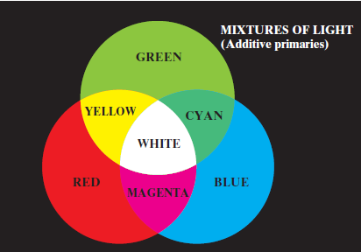
Color Fundamentals
The primary colors can be added to produce the secondary colors of light—magenta (red plus blue), cyan (green plus blue), and yellow (red plus green).

Slide 7
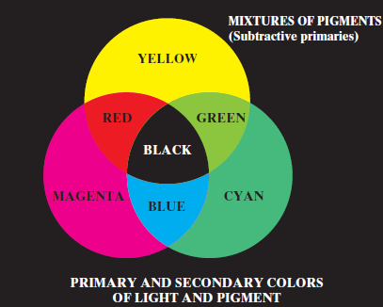
Color Fundamentals
A primary color (pigment) is defined as one that subtracts or absorbs a primary color of light and reflects or transmits the other two. Therefore, the primary colors of pigments are magenta, cyan, and yellow, and the secondary colors are red, green, and blue.

Slide 8
Color Fundamentals
The characteristics generally used to distinguish one color from another are brightness, hue, and saturation.
Brightness embodies the achromatic notion of intensity.
Hue is an attribute associated with the dominant wavelength in a mixture of light waves. Hue represents dominant color as perceived by an observer. Thus, when we call an object red, orange, or yellow, we are referring to its hue.

Slide 9
Color Fundamentals
Saturation refers to how pure a color is or the amount of white light mixed with a hue.
The pure spectrum colors (VIBGYOR) are fully saturated.
For example, bright red is highly saturated, while pink (red mixed with white) is less saturated, with the degree of saturation being inversely proportional to the amount of white light added.

Slide 10
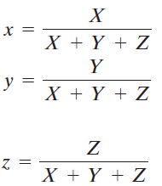
Color Fundamentals
Hue and saturation taken together are called chromaticity, and, therefore, a color may be characterized by its brightness and chromaticity.
The amounts of red, green, and blue needed to form any particular color are called the tristimulus values and are denoted, X, Y, and Z, respectively. A color is then specified by its trichromatic coefficients.

Slide 11
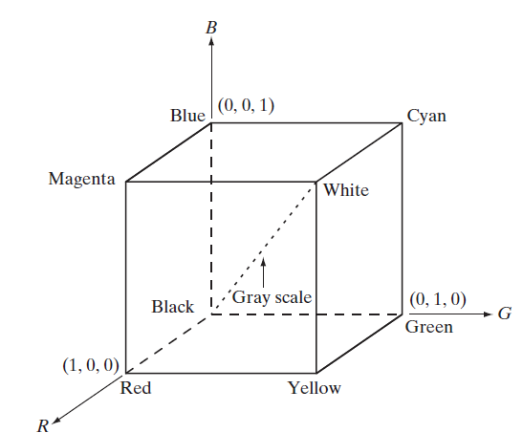
RGB Color Model
RGB primary values are at three corners; the secondary colors cyan, magenta, and yellow are at three other corners; black is at the origin; and white is at the corner farthest from the origin.
In this model, the gray scale (points of equal RGB values) extends from black to white along the line joining these two points.

Slide 12
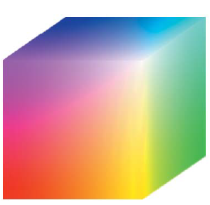

RGB Color Model
The number of bits used to represent each pixel in RGB space is called the pixel depth. Consider an RGB image in which each of the red, green, and blue images is an 8-bit image.
Each RGB color pixel [that is, a triplet of values (R, G, B)] is said to have a depth of 24 bits (3 image planes times the number of bits per plane).
The term full-color image is used often to denote a 24-bit RGB color image. The total number of colors in a 24-bit RGB image is

Slide 13
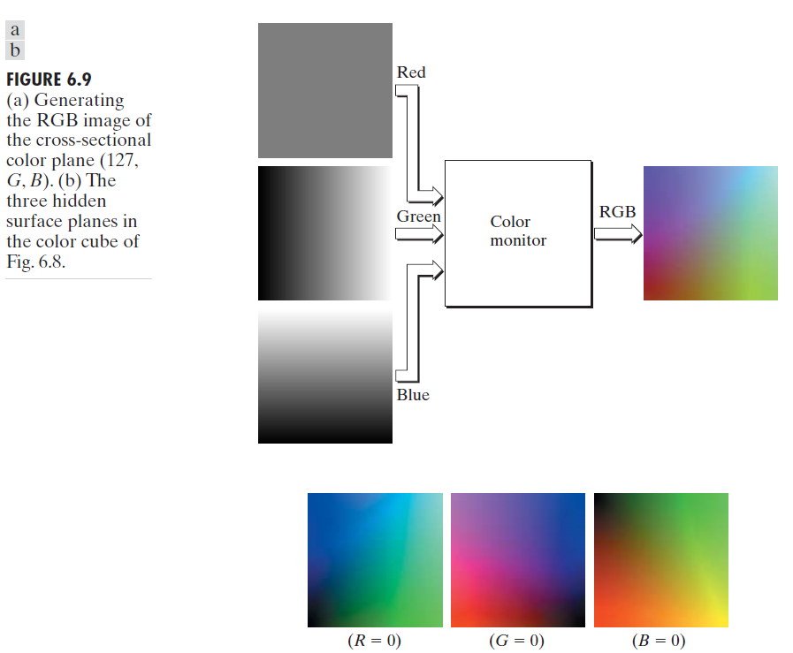
RGB Color Model

Slide 14
RGB Color Model
While high-end display cards and monitors provide a reasonable rendition of the colors in a 24-bit RGB image, many systems in use today are limited to 256 colors.
Web colors, also known as web-safe colors, refer to a palette of 216 colors that appear consistently across different web browsers and computer systems.
These 216 colors have become the de facto standard for safe colors, especially in Internet applications. They are used whenever it is desired that the colors viewed by most people appear the same.

Slide 15
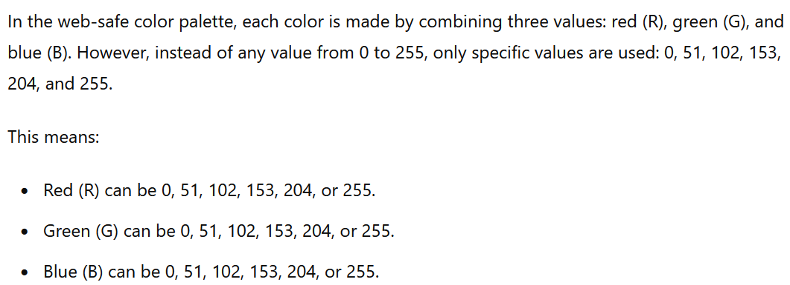
RGB Color Model

Slide 16
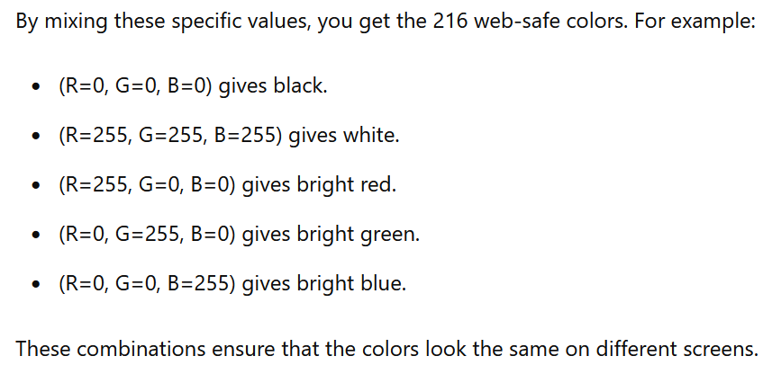
RGB Color Model

Slide 17
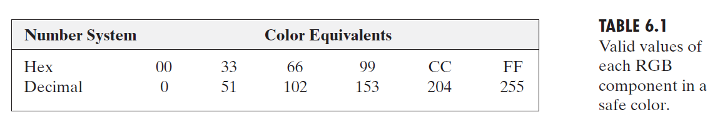
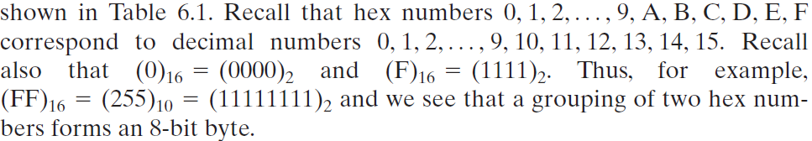
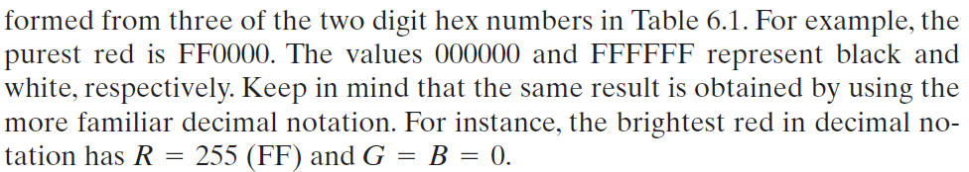
RGB Color Model

Slide 18
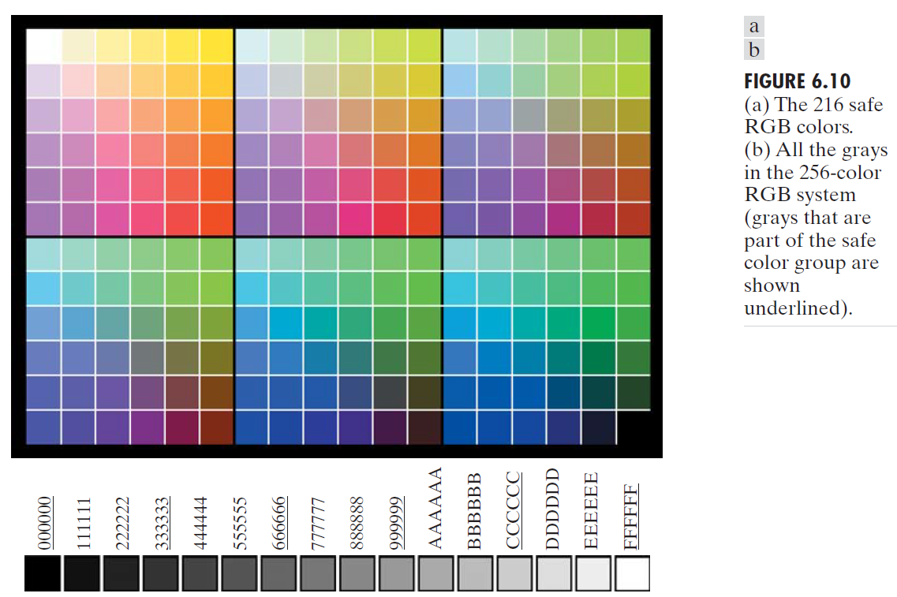

Slide 19
The square in the top left array has value FFFFFF (white), the second square to its right has value FFFFCC, the third square has value FFFF99.
The second row of that same array has values FFCCFF, FFCCCC, FFCC99. The final square of that array has value FF0000 (the brightest possible red).
The final (bottom right) square of the last array has value 000000 (black).

Slide 20
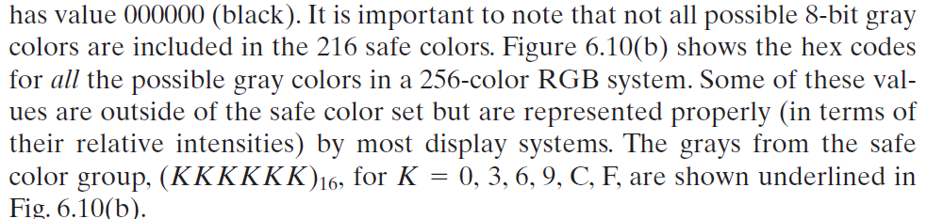

Slide 21
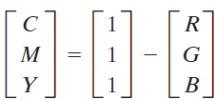
The CMY and CMYK Color Models
Cyan, magenta, and yellow are the secondary colors of light or, alternatively, the primary colors of pigments.
So, in order to produce true black (which is the predominant color in printing), a fourth color, black, is added, giving rise to the CMYK color model.

Slide 22
HSI Color Model
Color systems are ideally suited for hardware implementations.
Unfortunately, the RGB, CMY, and other similar color models are not well suited for describing colors in terms that are practical for human interpretation.
When humans view a color object, we describe it by its hue, saturation, and brightness.
Hue: The type of color (like red, blue, or yellow).
Saturation: How pure or vivid the color is (less white or gray means more saturated).
Intensity: The brightness or lightness of the color.

Slide 23




Converting colors from RGB to HSI

Slide 24
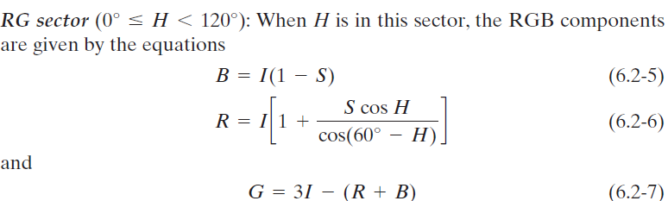
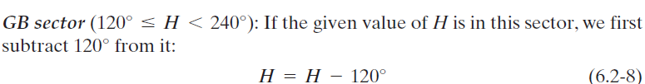
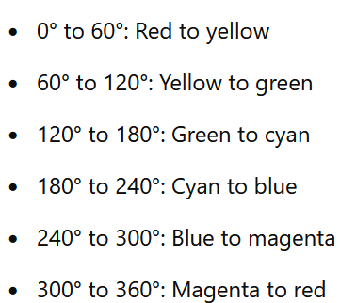
Converting colors from HSI to RGB

Slide 25
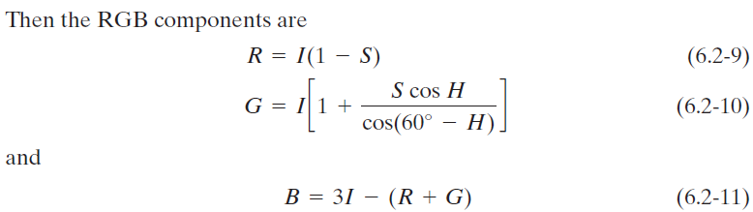
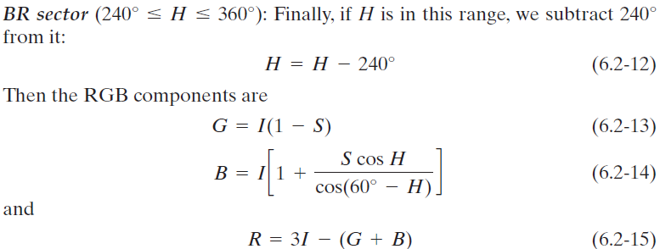
Converting colors from HSI to RGB

